Slide 1
PROJECT 6 CSC 685 ADVANCE MACHINE LEARNING
BY MINSHU DUBEY & DANNI JIN

Slide 2
REQUIRENMENTS
https://www.tensorflow.org/datasets/catalog/overview (Links to an external site.)
1) Select 4 types of image data
2) For each dataset, cluster the images using K-Means and plot the elbow graph to show the best K.
3) Train a classifier to determine which object is represented in each image and evaluate it on the validation set.
4) Use K-Means as a dimensionality reduction tool and train a classifier on the reduced set. Search for the number of clusters that provides the best performance.
5) Train a Gaussian mixture model on each dataset. To speed up the algorithm, use PCA dimensionality reduction (99% variataion).
6) Graph results of your experiments for the different data sets and provide a qualitative assessment and detailed discussion of the achieved results.

Slide 3
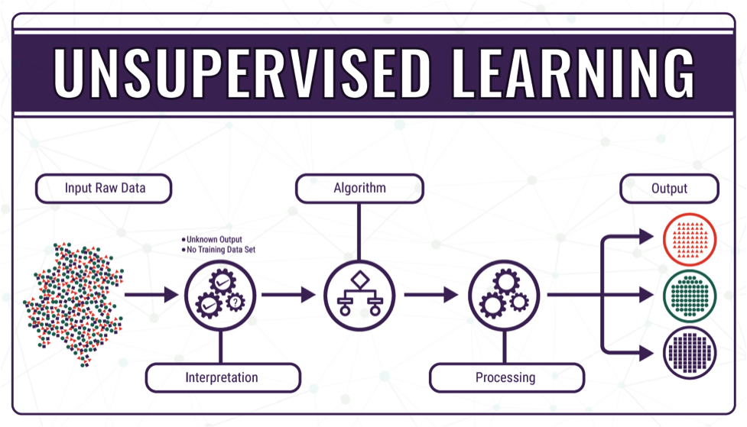
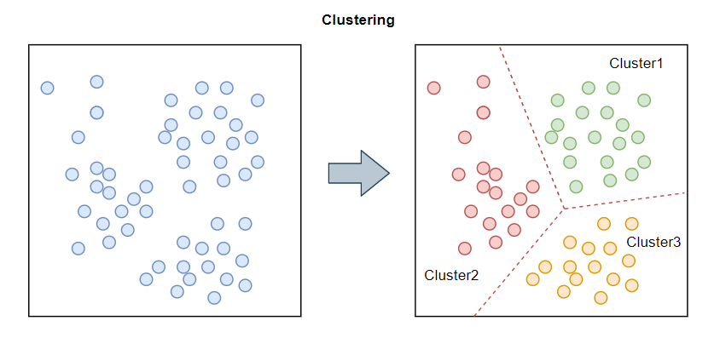
INTRODUCTION
Unsupervised learning is a type of machine learning algorithm used to draw inferences from datasets consisting of input data without labeled responses.
The most common unsupervised learning method is cluster analysis, which is used for exploratory data analysis to find hidden patterns or grouping in data. The clusters are modeled using a measure of similarity which is defined upon metrics such as Euclidean or probabilistic distance.

Slide 4
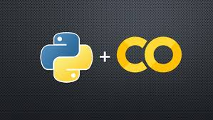
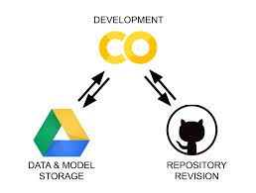
TOOLS USED
Google Colab
Python
GitHub

Slide 5
Ranking PAGE
Minshu Dubey(50%)
Selected COIL100 DATASET
Did all the requirements from 1 to 6
Report
Danni Jin(50%)
Selected AFLW2000-3D DATASET
Did all the requirements from 1 to 6
NOTE: DUE TO LESS STORAGE AND WORKING ON CLOUD WE ONLY TOOK 2 DATASETS.

Slide 6
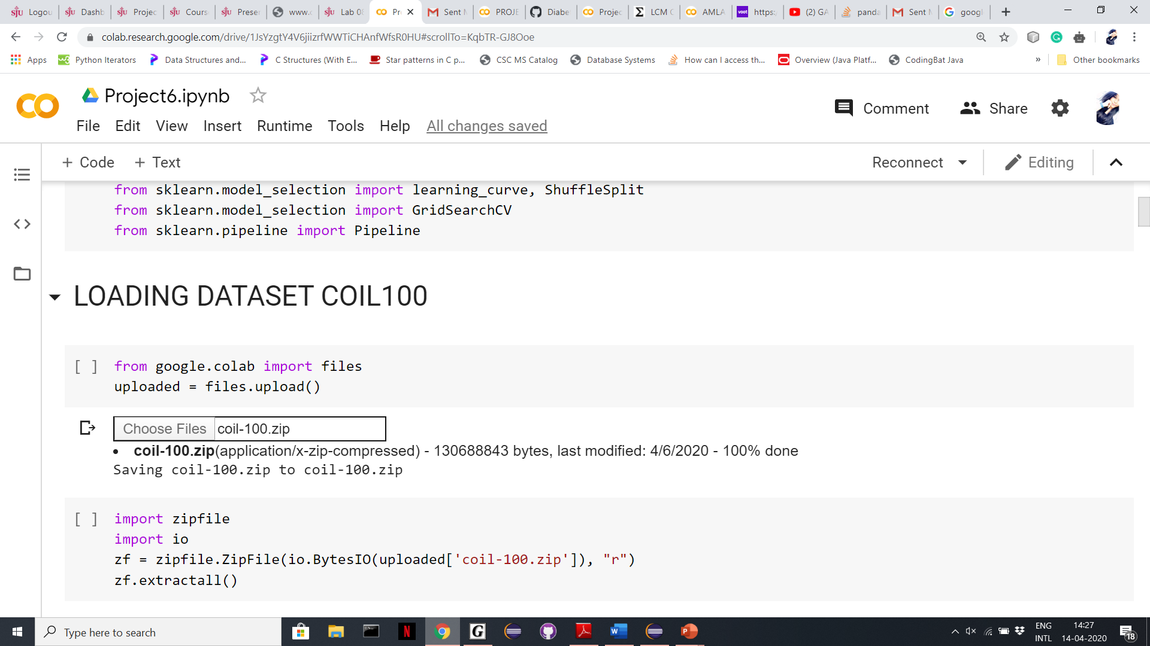
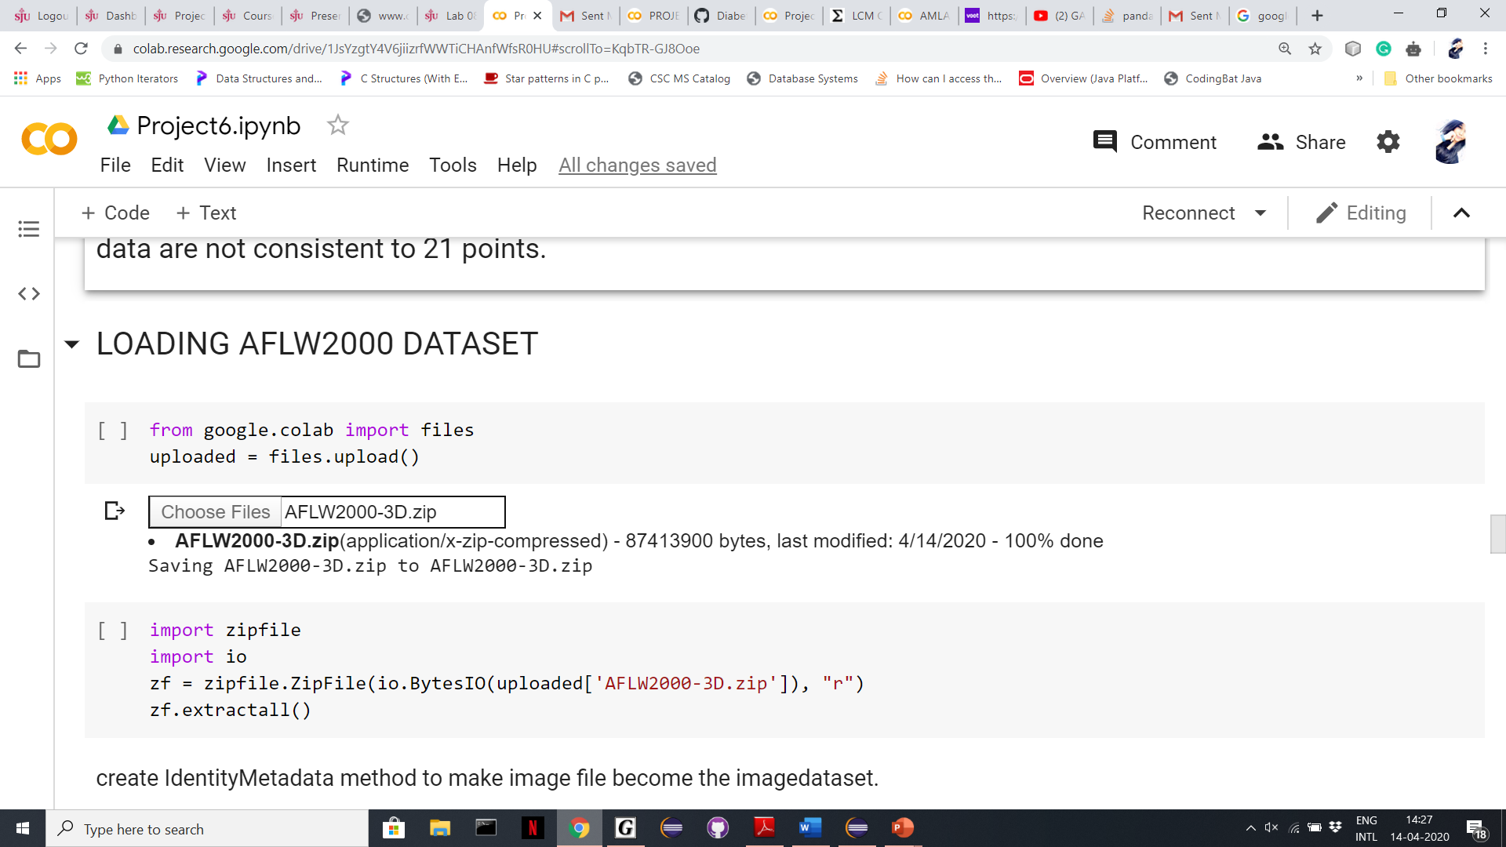
IMPORTING AND LOADING OF DATASETS
Imported via zip files on google colab.

Slide 7
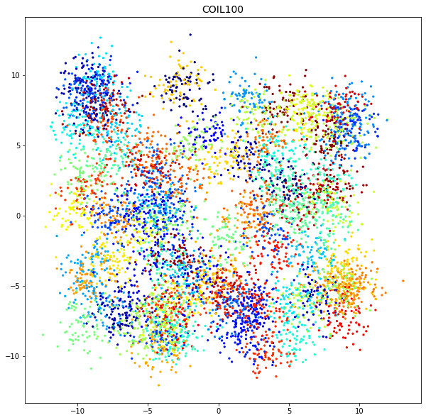
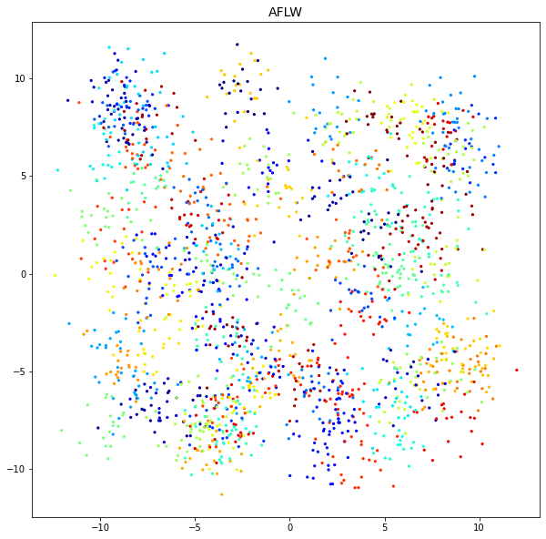
isotropic Gaussian blobs for clustering COIL100 & AFLW2000-3D

Slide 8
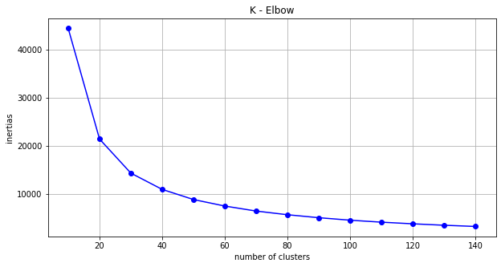
K MEANS ELBOW GRAPH FOR BEST K COIL100 AFLW2000-3D

Slide 9
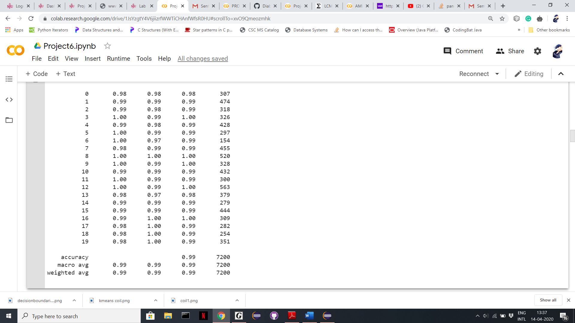
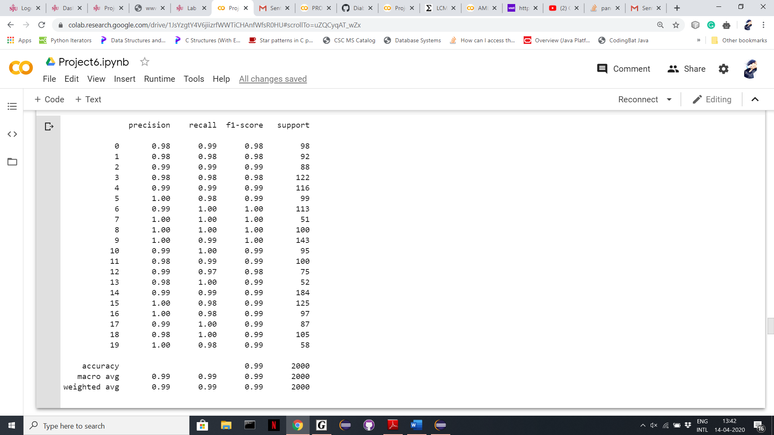
SCORE REPORT COIL100 AFLW2000-3D

Slide 10
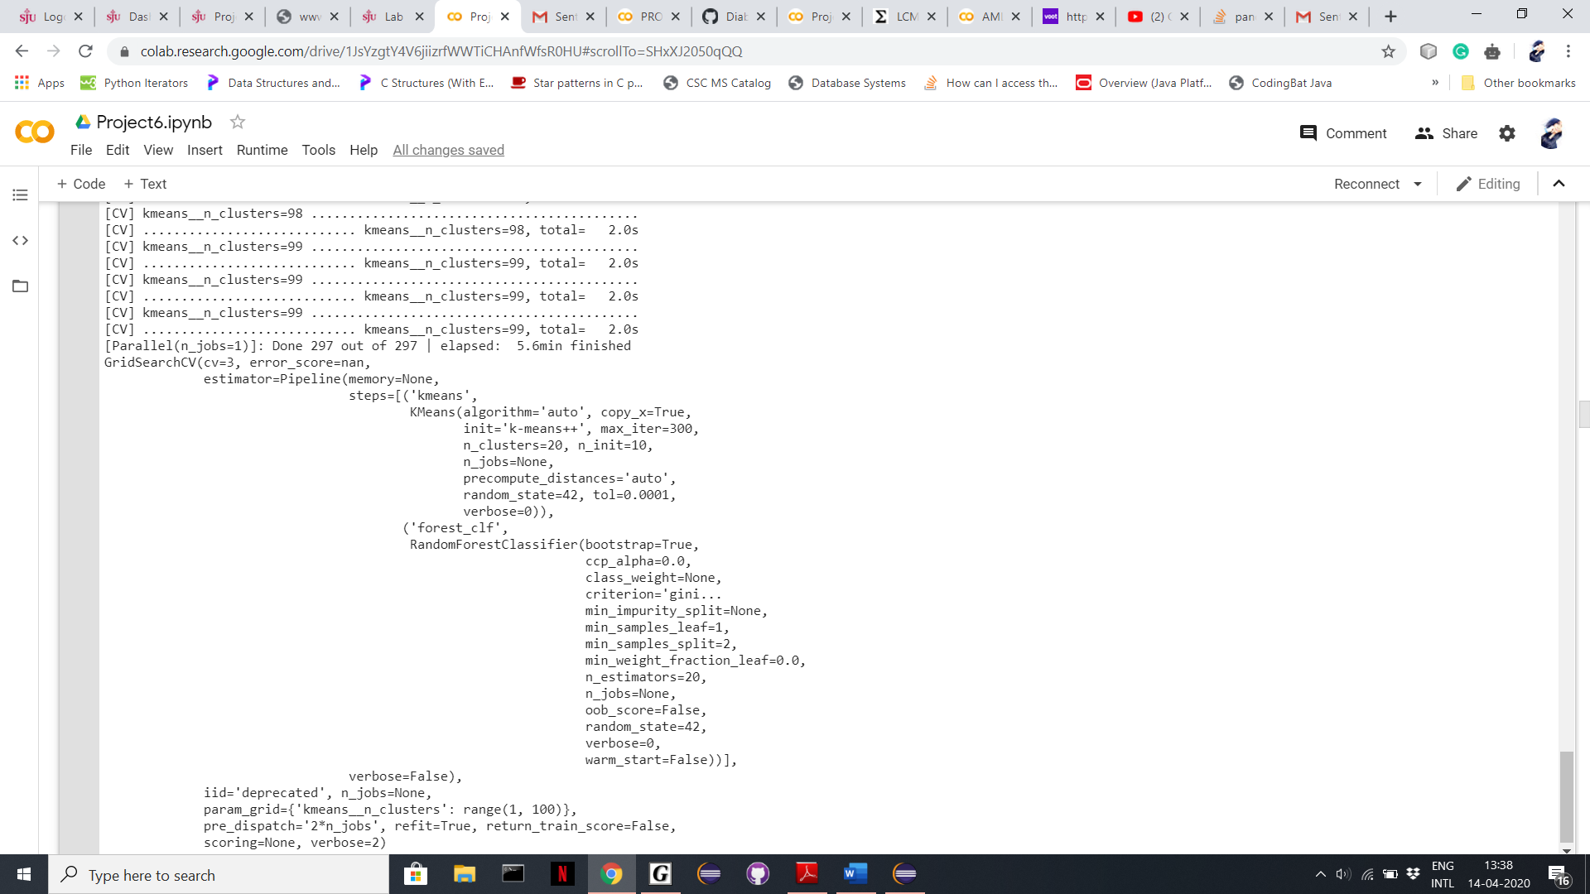
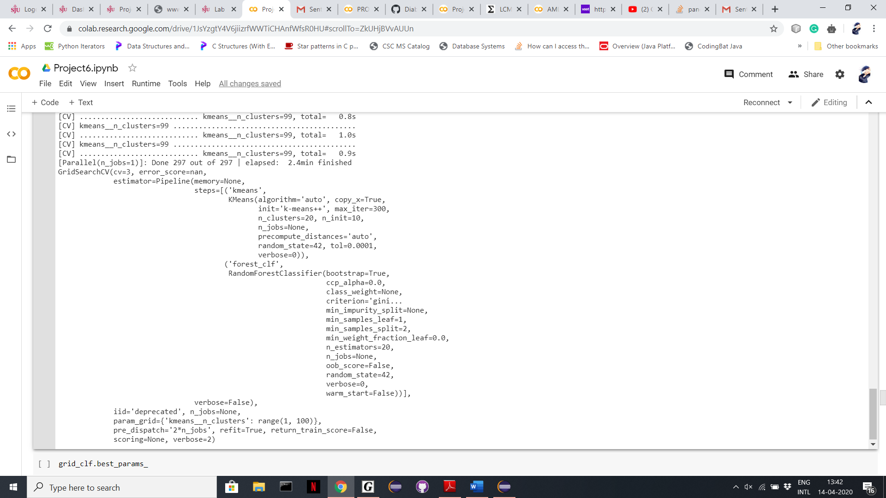
GRID SEARCH COIL100(TOOK TIME:5.6MIN) AFLW2000-3D(TOOK TIME:2.4MIN)

Slide 11
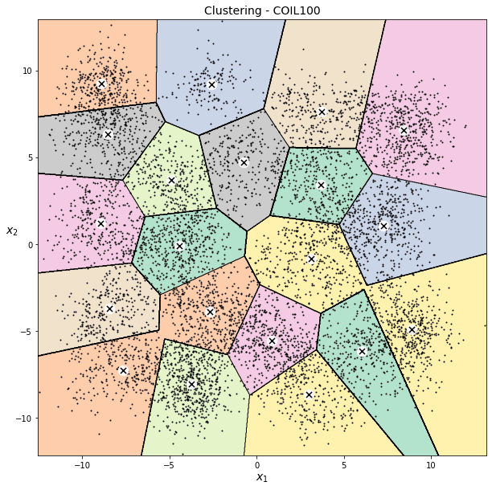
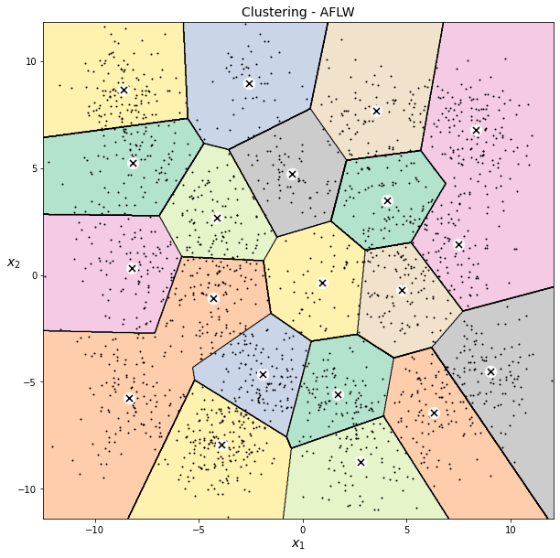
DECESION BOUNDARIES COIL100 AFLW2000-3D

Slide 12
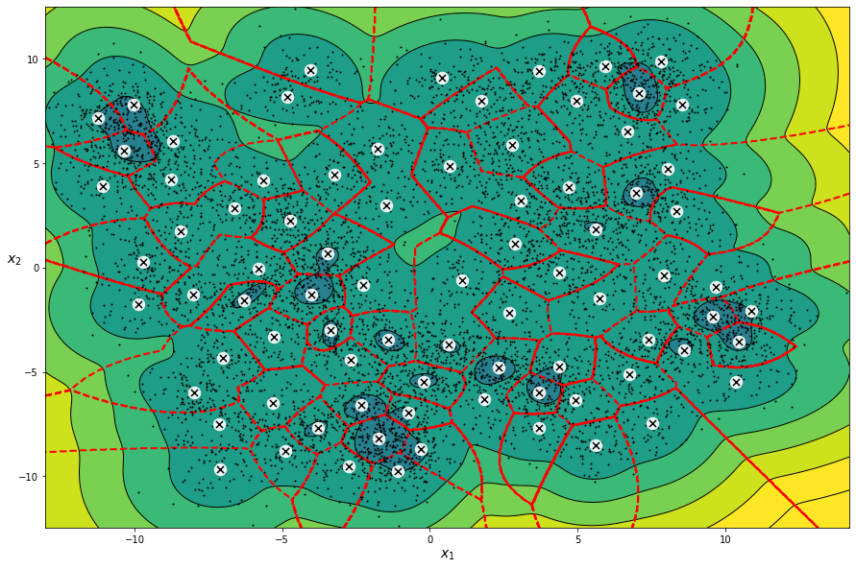
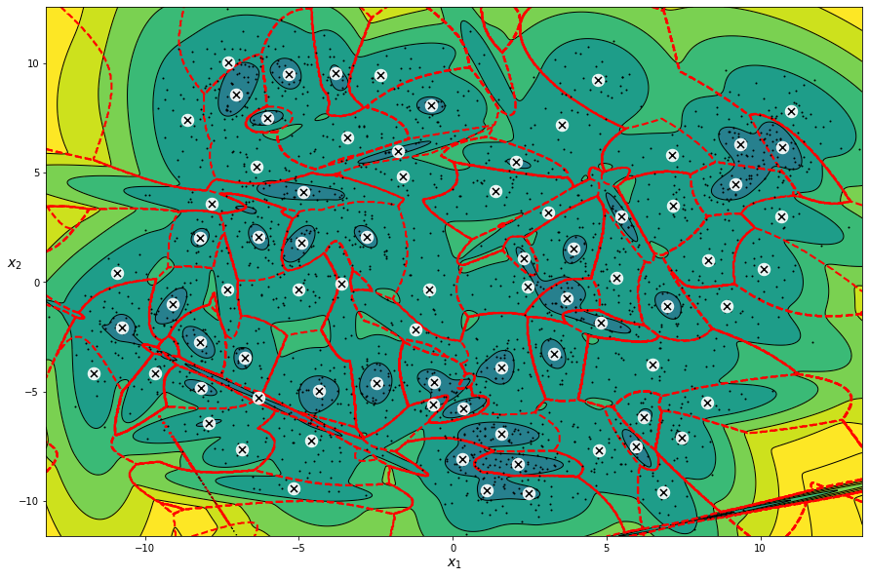
RESULTING DECESION BOUNDARIES COIL100 AFLW2000-3D

Slide 13
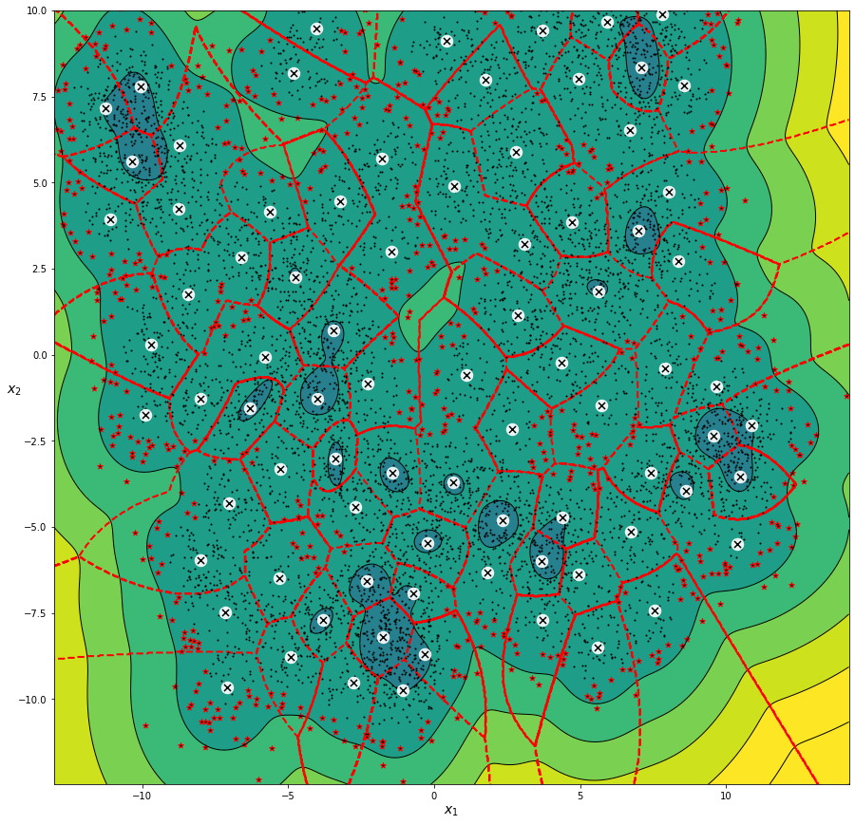
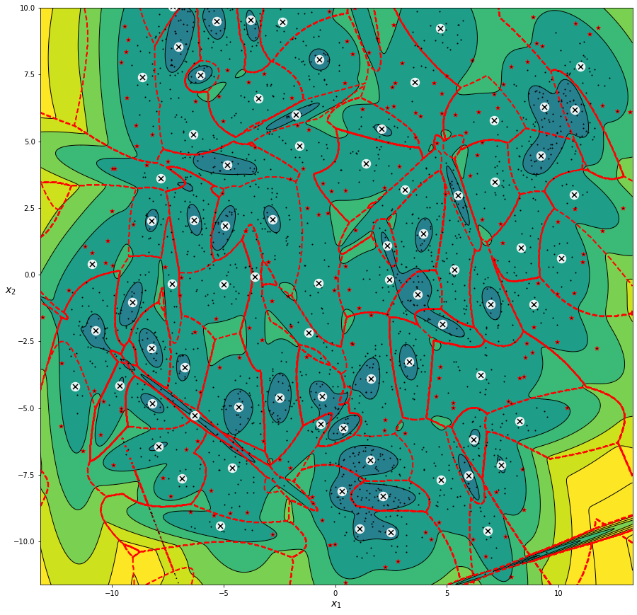
ANOMOLY DETECTION COIL100 AFLW2000-3D

Slide 14
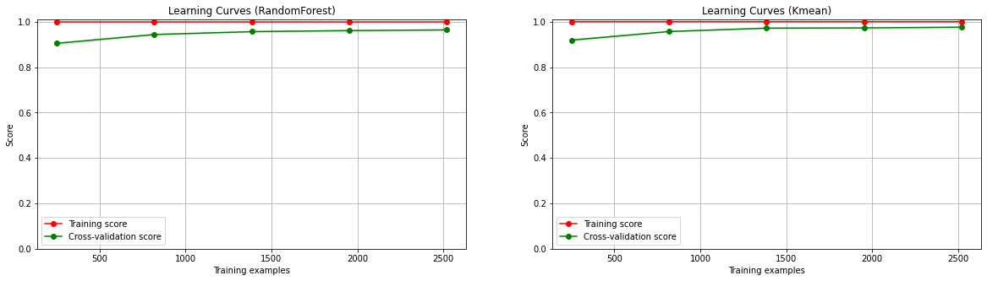
LEARNING CURVE COIL100

Slide 15
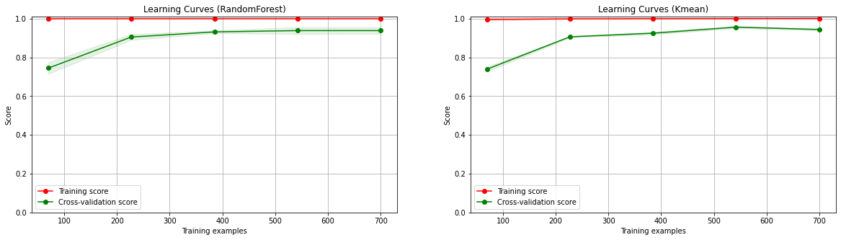
LEARNING CURVE AFLW2000-3D

Slide 16
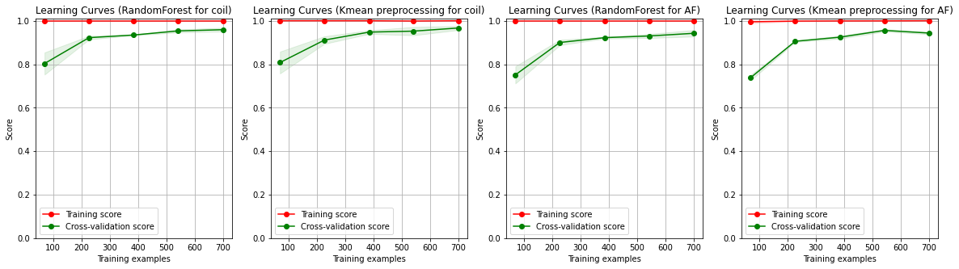
COMPARISION OF TRAINING EXAMPLE OF RANDOM FOREST AND KMEANS PREPROCESSING ON COIL100 AND AFLW2000-3D

Slide 17
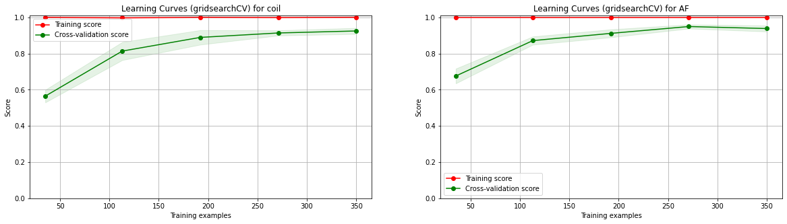
COMPARING GRID SEARCH LEARNING CURVE OF COIL100 AND AFLW2000-3D

Slide 18
CONCLUSION
In this project, we used 2 different image datasets that is COIL100 & AFLW2000-3D to gain experience in applying various clustering algorithms(Unsupervised Learning).
In COIL100 took a bit more time in training in comparision to AFLW because of large dataset.
When the cluster is 20 and both dataset we choose first 500 image:
Pipe score of COIL100: 0.9462
Pipe score of AFLW2000-3D: 0.9733
RandomForest Cross Validation score of COIL100: 0.93
RandomForest Cross Validation score of AFLW200-3D: 0.9299
kmeans Cross Validation score of COIL100 for preprocessing: 0.075
kmeans Cross Validation score of AFLW200-3D for preprocessing: 0.054
Grid Classifier score of COIL100: 0.9481 Grid Classifier score of AFLW2000-3D: 0.9716
After comparing certain values such as pipe score,cross validation and accuracy score we came to the conclusion that COIL100 did a bit better that AFLW200-3D.
Above the picture that we can see, as the cluster become bigger, the coil100 is perfoming a little better than the AFLW200-3D.

Slide 19
THANKYOU

